Slide 1
Antibody kinetics :
- The synthesis and Secretion of antibody can be evaluated with respect to time.
- Monomeric IgM serves as the B-cell receptor for antigen and pentameric IgM is the first type of antibody secreated after B- cell activation.
- Under the influence of T- helper cells, IgM- secreting plasma cells may switch and produce another antibody class (e.g, IgG, IgA, or IgE). Known as antibody class switching.

Slide 2
The Primary antibody Response :
- When an individual is exposed to an antigen (e.g; an infection or vaccine), there is an initial lag phase or latent period (up to several weeks), before an antibody response is mounted.
- During this latent period, no antigen-specific antibody can be detected in the blood.(Fig.)
- once B cells have differentiated into plasma cells, antibody is secreted and can be detected.

Slide 3
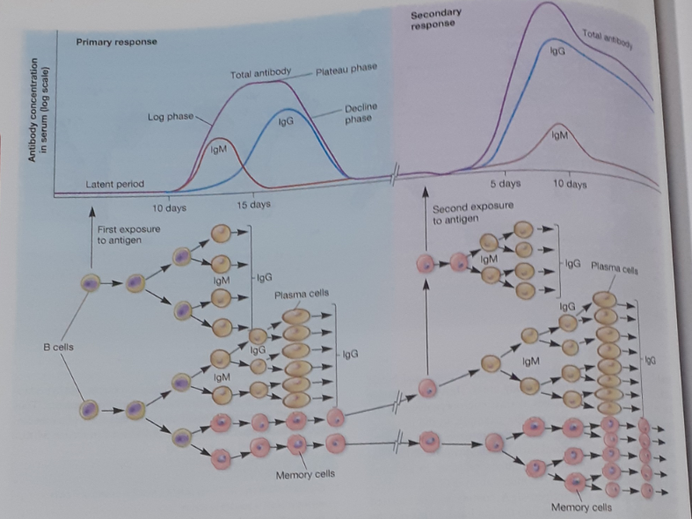

Slide 4
- During the primary antibody response, IgM appears first, then switches to another antibody class usually IgG.
- The affinity of antibodies for the antigen’s determinants is low to moderate during primary antibody response.
- The Antibody Titer, - is a mesasurement of serum antibody conc.( the reciprocal of the highest dilution of an antiserum that gives a positive reaction in the test being used) , then rises logarithmically to a plateau during the second , or log phase.
- In plateau phase antibody titer stabilizes.

Slide 5
- followed by a decline phase during which antibodies are naturally metabolized or bound to the antigen and cleared from circulation.
The Secondary Antibody Response :
- The primary antibody response primes the immune system so that it possesses specific immunological memory through its clones of memory B cells, each of which respond to a different antigen.
- When an individual is reexposed to a pathogen or receives a vaccine boosters, B cells amounts a heightened secondary response to the same antigen (Fig).

Slide 7
- Compared to the primary antibody response , Secondary antibody response has a shorter lag phase and a more rapid log phase, persist for a longer plateau period, attains a higher IgG titer and produces antibodies with a higher affinity for the antigen.

